Slide 1
BDCD
Polar Bears

Slide 2
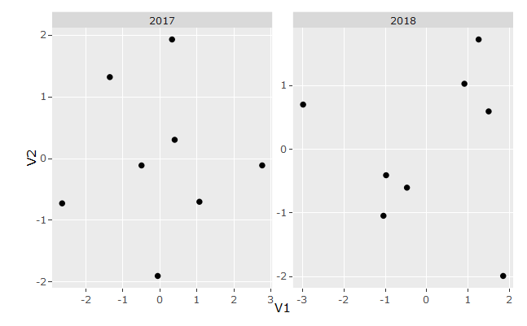

Slide 3
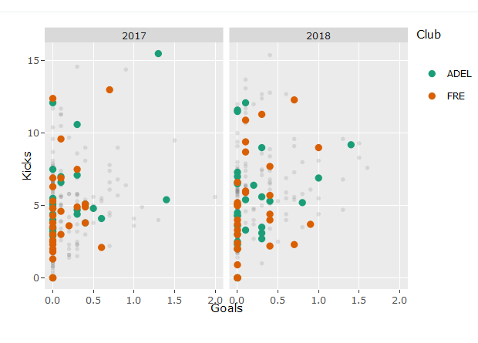

Slide 4
Final Sentence
Despite having games where they are too ‘low-scoring’, the AFLW is still a developing league, which will likely grow over the coming years.
Aiden, John, Dom, Izzy, Jess.

